Slide 1
Lecture No. 10 Corrosion Science
At the end of this lecture, students will be able to:
Explain differential aeration corrosion
Water-line corrosion
Pitting corrosion
Describe stress corrosion with specific reference to boiler corrosion
Identify the primary factors affecting corrosion

Slide 2
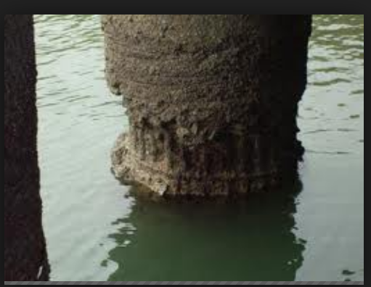
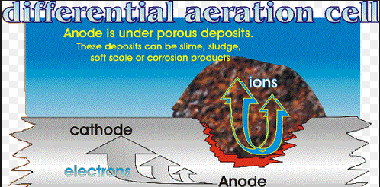
Differential Aeration Corrosion
Occurs due to difference in the concentration of air over the surface of a metal

Slide 3
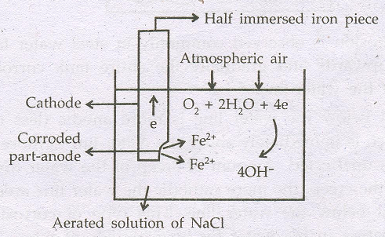
Differential Aeration Corrosion
Anodic reaction: At bottom (Low concentration of air)
Fe → Fe²⁺ + 2e⁻
Cathodic reaction: At top (Higher concentration of air)
O₂ + 2H₂O + 2e → 4OH⁻

Slide 4
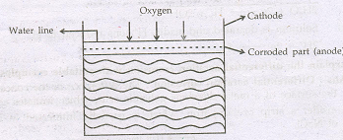
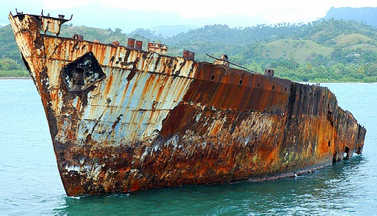
Differential Aeration Corrosion
Examples of Differential aeration corrosion:
Water-line corrosion
Pitting corrosion
1. Water-Line corrosion:
Corrosion is observed in steel water tanks, ships floating in seawater etc.
Area just below the water line is less exposed to air and act as anode
Area just above the water line is more exposed to air and act as cathode

Slide 5
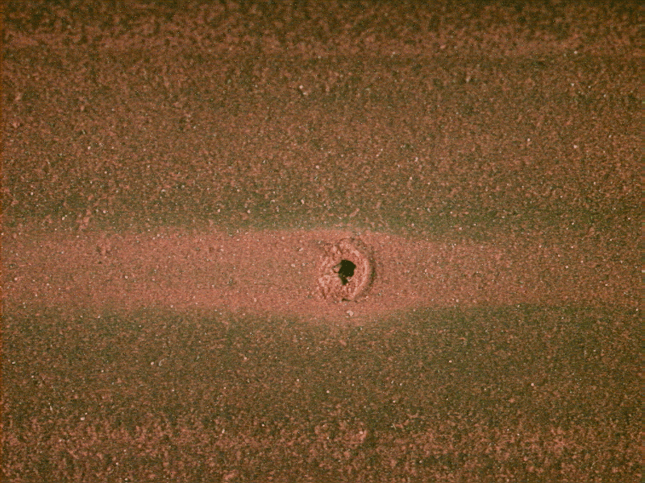
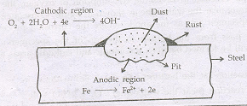
Differential aeration corrosion
2. Pitting Corrosion:
Occurs when dust particles get deposited on the metal surface
Portion covered by the particles will be less aerated compared to exposed area and act as anode
Portion which is exposed more to air/oxygen act as cathode
Pitting corrosion is localized and intense

Slide 6
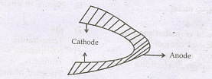
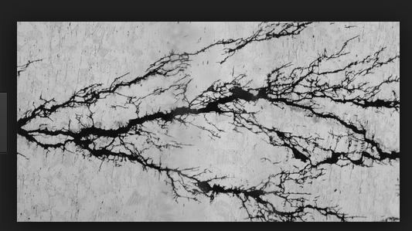
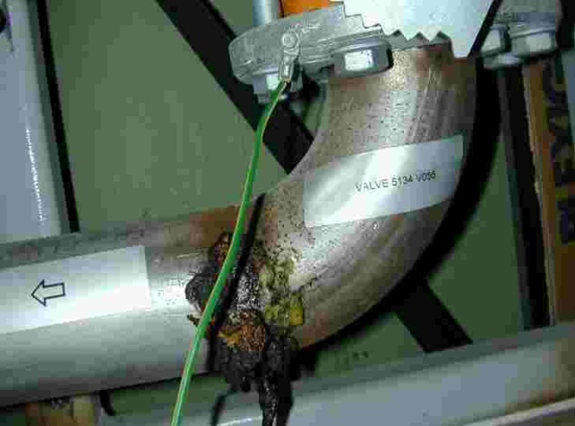
3. Stress Corrosion
Observed at stressed points of metal and alloy in a corrosion environment
Occurs more rapidly at stressed portions caused by welding, riveting, bending, pressing, cold working etc.
Ex: This type of stress corrosion occurs in mild steel boilers due to the presence of alkaline impurities in boiler water.
Na₂CO₃ + H₂O → 2NaOH + CO₂
SEM Micrograph of Stress Corrosion
Notes:
In boiler at stressed points like rivets, joints, bends etc. will have minute hair cracks. Inside these cracks boiler water containing alkaline impurities enter through capillary action. Later water evaporates leaving behind caustic soda in the cracks. This leads to electrochemical cells. Hairline cracks with concentrated alkaline impurities acts as anode and gets corroded. Main boiler body in contact with weak alkaline water becomes cathode. Due to corrosion at stressed points boiler failure may occur.

Slide 7
Caustic Embrittlement
When the concentration of alkali increases beyond 10%, it will lead to the formation of sodium ferroate which further undergoes decomposition and intense corrosion occurs at this part
Na₂CO₃ + H₂O → 2 NaOH + CO₂
Fe + NaOH → Na₂FeO₂
3 Na₂FeO₂ + 4 H₂O → 6 NaOH + Fe₃O₄ + H₂
6 Na₂FeO₂ + 6 H₂O + O₂ → 12 NaOH + 2 Fe₃O₄ (magnetite)

Slide 8
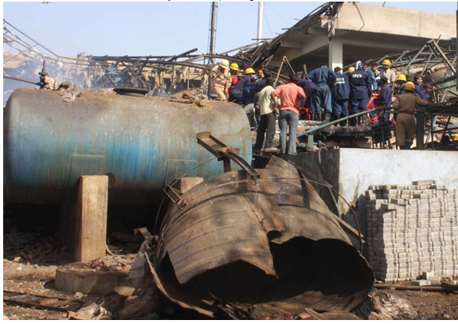
Boiler Corrosion
Decay of boiler material with environment is called boiler corrosion
Boiler corrosion is the active destruction of boiler metal by the pitting action of dissolved oxygen in the boiler water
Pitting site can develop deep penetration through boiler metal to cause ultimate failure

Slide 9
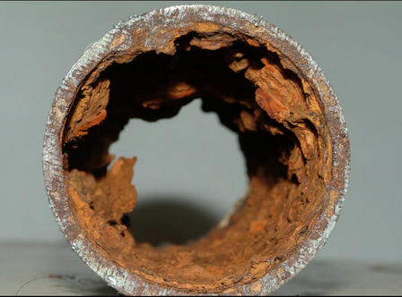
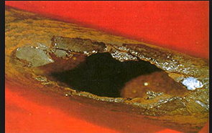
Effects of Boiler Corrosion
Boilers are usually the heart of many manufacturing processes
Corroded boilers can result in significant safety concerns and expensive downtime to effect repairs or replacement

Slide 10
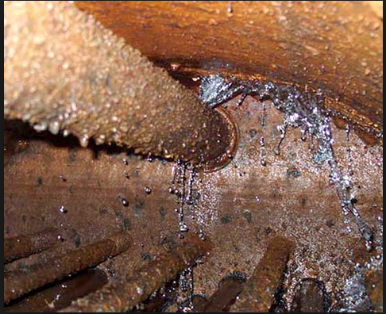
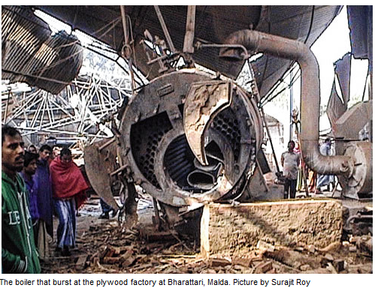
Effects of Boiler Corrosion…….
Failure of boiler tubes by corrosion attack has been a familiar phenomenon in power plants resulting in unscheduled plant shut down
Consequence to this there are heavy losses in industrial production and disruptions to civil amenities
Failure of boiler tubes appears in the form of bending, bulging, cracking, wearing or rupture, causing leakage of the tubes

Slide 11
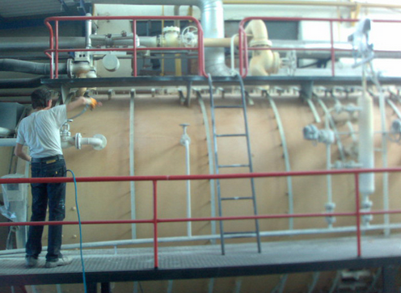
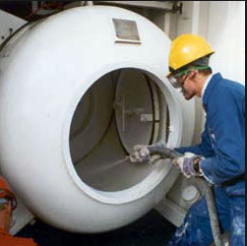
Boiler Corrosion Control
Boiler corrosion can be controlled by the use of proper metal to prepare boiler and using of pre treated water
Pre treated water will protect from caustic attack
Phosphate buffers are added to reduce the change in pH
Excess caustic combines with disodium phosphate and forms trisodium phosphate, by the following reaction:
This results in the prevention of caustic build up

Slide 12
Factors Affecting Rate of Corrosion:
Primary Factors (Nature of metal)
Electrode potential
Areas of anode and cathode
Nature of corrosion products formed
Secondary Factors (Environmental)
pH
Temperature
Conductance of medium
Humidity
Presence of impurities in environment

Slide 13
Primary Factors Affecting Rate of Corrosion…..
Electrode Potential:
The corrosion rate of differential metal corrosion depends on the potential difference between the two metals
If the potential difference between two metals is larger, higher will be the corrosion rate
For example: The potential difference between iron and copper is 0.78 V, which is more than between iron and tin (0.3V)
(Eº _{Fe++⎟Fe} = -0.44 V; and Eº _{Cu++⎟Cu} = 0.34 V )
(Eº _{Fe++⎟Fe} = -0.44 V and Eº _{Sn++⎟Sn} = -0.1 4 V )
Therefore, iron corrodes faster in contact with copper than with tin. Hence, the use of dissimilar metals should be avoided
Notes:
(Eº _{Fe++⎟Fe} = -0.44 V; Eº _{Cu++⎟Cu} = 0.34 V and potential difference is 0.78 V)
than that between iron and tin
(Eº _{Fe++⎟Fe} = -0.44 V; Eº _{Sn++⎟Sn} = -0.1 4 V and potential difference is 0.3 V).

Slide 14
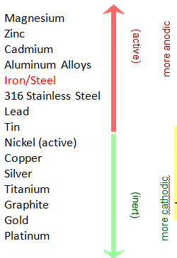
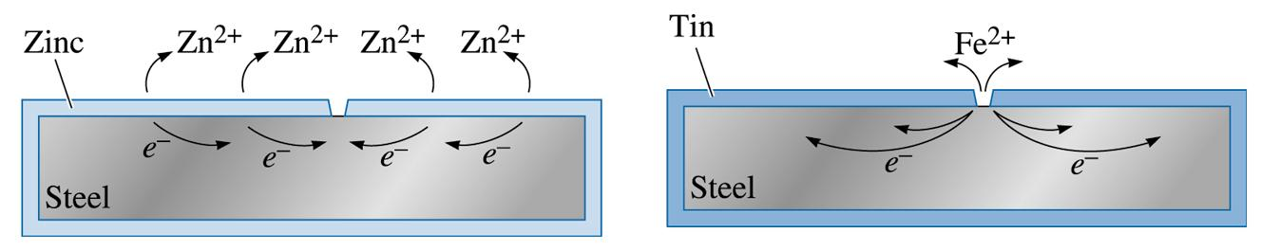
Primary Factors Affecting Rate of Corrosion…..
2. Anodic and Cathodic Area: Corrosion of a metal occurs fast if the anode area is small and the cathode area is large
©2003 Brooks/Cole, a division of Thomson Learning, Inc. Thomson Learning™ is a trademark used herein under license.

Slide 15
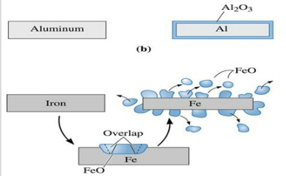
Primary Factors Affecting Rate of Corrosion…..
3. Nature of corrosion product formed:
Product of corrosion is usually oxide of the metal
Forms a thin layer on the metal surface
The nature of oxide layer formed determines the corrosion rate

Slide 16
Summary
Differential aeration corrosion : Water-line corrosion and Pitting corrosion
Stress corrosion with specific reference to boiler corrosion
Factors affecting corrosion can be primary Factors (Nature of metal) such as electrode potential, Areas of anode and cathode

